Slide 1
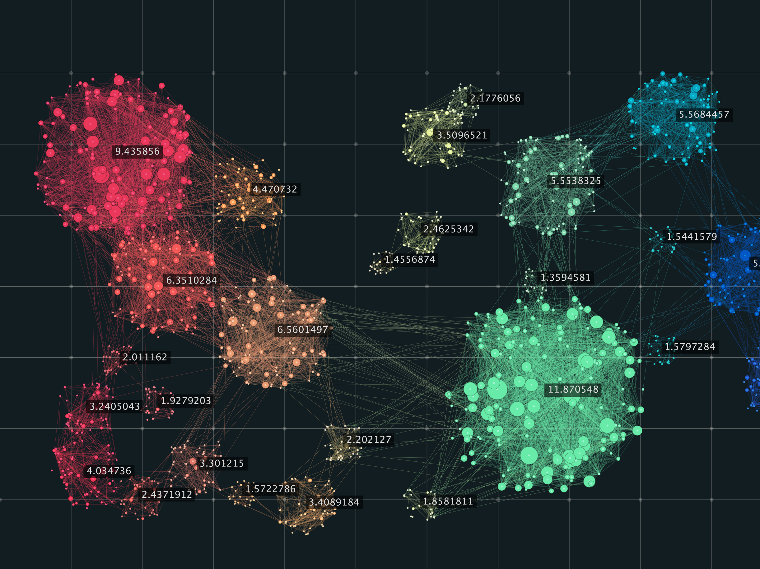
Clustering

Slide 2
Cluster Analysis
Grouping objects in meaningful way
Clustered data fits together in some way
Often done to make sense of (big) data
Useful analysis technique in many fields
Many different clustering strategies
We consider 2 clustering methods
K-means and EM clustering
But first, some background topics…
Notes:
Clustering often used for “data exploration”.

Slide 3
Intrinsic vs Extrinsic
Intrinsic clustering relies on unsupervised learning
No predetermined labels on objects
Apply analysis directly to data
Extrinsic relies on category labels
Requires pre-processing of data
Can be viewed as a form of supervised learning

Slide 4
Agglomerative vs Divisive
Agglomerative
Each object starts in its own cluster
Cluster by merging existing ‘small’ clusters
A “bottom up” approach
Divisive
All objects start in one ‘very large’ cluster
Clustering process splits existing clusters
A “top down” approach

Slide 5
Hierarchical vs Partitional
Hierarchical clustering
“Child” and “parent” clusters
Can be viewed as dendrograms
Partitional clustering
Partition objects into disjoint clusters
No hierarchical relationship
We consider K-means and EM in detail
These are both partitional
Notes:
Partitional clustering can be viewed as implying a “degree of membership”. Depending on how we assign data points to clusters, in such cases, we need not have strictly disjoint clusters.

Slide 6
Dendrogram
Example
Obtained by hierarchical clustering

Slide 7
Hierarchical Clustering
Example of hierarchical clustering...
Start with every point is its own cluster
While number of clusters exceeds 1
Find 2 “nearest” clusters and merge
End while
This would be based on a function that defines ‘distance’ between clusters
But it’s not very theoretically sound… yet
This is also an agglomerative approach

Slide 8
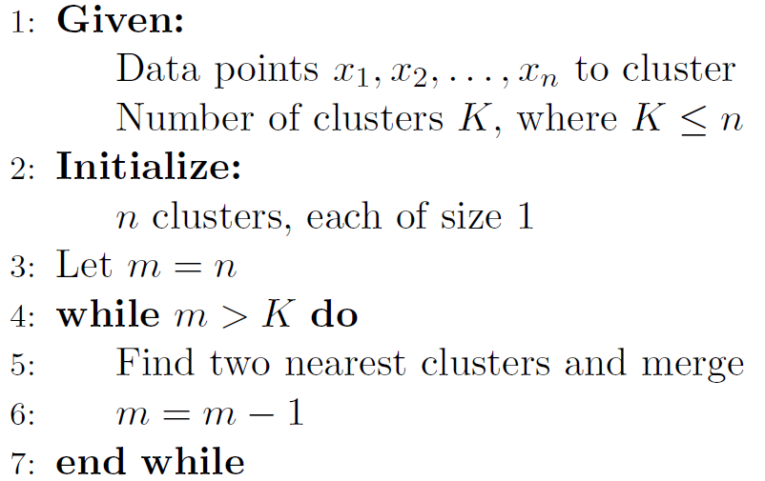
Hierarchical Clustering

Slide 9
Distance
Distance between data points?
Let’s see two very common examples. Suppose:
x = (x₁,x₂,…,x_{n}) and y = (y₁,y₂,…,y_{n})
where each x_{i} and y_{i} are real numbers
Euclidean distance is:
Manhattan (taxicab) distance is:
Notes:
Lots and lots of other distance measures can be considered (some are mentioned later in these slides).

Slide 10
Distance
Euclidean distance ⎯ red line
Manhattan distance ⎯ blue or yellow
Or any similar right-angle only path
b
a

Slide 11
Distance
Lots and lots more distance measures
Other examples (kinda less intuitive) include:
Mahalanobis distance ⎯ includes means and covariance in distance measure
Simple substitution distance ⎯ measure of “decryption” distance
Chi-squared “distance” ⎯ statistical
Sometimes use non-distance measures, such as cosine similarity
Usually for spherical K-means clustering

Slide 12
An Approach to Clustering…
Given data points x₁,x₂,x₃,…,x_{m}
Want to partition into K clusters
A centroid specified for each cluster
Let c₁,c₂,…,c_{K} denote current centroids
Each x_{i} associated with one centroid
Let centroid(x_{i}) be centroid for x_{i}
If c_{j} = centroid(x_{i}), then x_{i} is in cluster j
Notes:
The centroid can be viewed as the center of mass of a cluster, and clusters are defined in terms of centroids.

Slide 13
Questions
Two general questions…
How to determine centroids, c_{j}?
How to determine clusters, that is, how to assign the {x_{i}} to centroids?
But first, what makes a cluster “good”?
For now, focus on one individual cluster
Relationship between clusters later…

Slide 14
Distortion
Intuitively, “compact” clusters good
Depends on data and K, which are given
And depends on centroids and assignment of x_{i} to clusters, which we can control
How to measure “goodness”?
Note that we are assuming K is specified in advance.
Notes:
Recall that K is the number of clusters

Slide 15
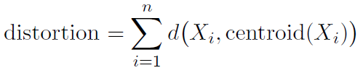
Distortion
Define distortion as:
Where d(x,y) is a distance measure
Given K, let’s try to minimize distortion
How to measure “goodness”?

Slide 16
Example
Consider this 2-d data
Choose K = 3 clusters
Same data for both
Which has smaller distortion?
How to minimize distortion?
Good question…

Slide 17
Minimize Distortion
Note that distortion depends on K
So, we should probably write distortion_{K}
Want to solve the following problem:
Given: K and x₁,x₂,x₃,…,x_{m}
Minimize: distortion_{K}
Best choice of K is a separate issue
Briefly considered this later
For now, assume K is given and fixed

Slide 18
How to Minimize Distortion?
Assume we are given m data points and K
Minimize distortion via exhaustive search?
Can we try all possible cases?
Way too much work for realistic size data set
An exact solution is NP-complete problem
Even for 2-dimensional data
An approximate solution will have to do

Slide 19
How to Minimize Distortion?
Key Observations:
Each x_{i} clustered with nearest centroid
Centroid must be at the center of its cluster
“Key observation” #1 is obvious
“Key observation” #2 is not quite so obvious, but can be verified using some basic calculus
Minimize distortion function by taking partial derivatives and set to 0

Slide 20
K-Means
Previous slide implies that we can improve suboptimal cluster by either…
Reassign each x_{i} to nearest centroid
Recompute centroids as cluster centers
No improvement from applying either 1 or 2 more than once in succession
But alternating might be useful
In fact, that is the K-means algorithm
Notes:
Alternating between these 2 steps gives us an iterative hill climb algorithm. This is analogous to HMM training where we alternate between computing parameters (alphas, betas, gammas, and di-gammas) and re-estimating the matrices (A, B and pi).

Slide 21
We have a single cluster and its centroid
Centroid
Sample point

Slide 22
What happens when a new point is added to such cluster?
Centroid
Sample point

Slide 23
What happens when a new point is added to such cluster?
Centroid
Sample point

Slide 24
What happens when a new point is added to such cluster?
Centroid
Sample point

Slide 25
K-Means Algorithm
Given dataset…
Select a value for K (how?)
Select initial centroids (how?)
Group data by nearest centroid
Recompute centroids (cluster centers)
If “significant” change, then goto 3; else stop

Slide 26
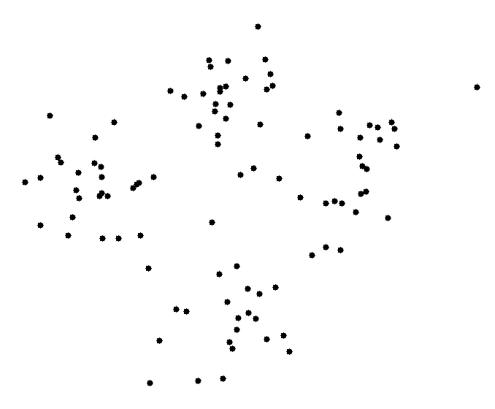
Notes:
http://shabal.in/visuals/kmeans/2.html

Slide 27
K-Means
Are we assured of optimal solution?
Definitely not!
Why not?
Initial centroid locations matter (a lot)
Dependence on initial centroids
This is a common issue in iterative processes (HMM training, for example)
This is a generic problem for a hill climb

Slide 28
K-Means Initialization
Recall, K is the number of clusters
How to choose K?
No obvious “best” way to do so
But K-means is fast
So trial and error may be OK
That is, experiment with different K
Similar to choosing N in HMM
Is there a better way to choose K?
Notes:
To sensibly choose “best” K, we need some way to measure the “quality” of resulting clusters.

Slide 29
Optimal K?
Even for trial and error, we need a way to measure “goodness” of results
Choosing optimal K is tricky
Intuitive measures of quality will likely improve for larger K
But if K is “too big”, may overfit
In extreme, every point is its own cluster
When is K big enough, but not too big?

Slide 30
K-Means Initialization
How to choose initial centroids?
Again, no best way to do this
Counterexamples to any “best” approach
Often just choose at random
Or uniform/maximum spacing
Or some variation on this idea
Other?

Slide 31
K-Means Initialization
In practice, we might do following:
Try several different choices of K
For each K, test several initial centroids
Select the result that is best
Might not be very scientific, but often it’s good enough
Okay, but how to measure “best”?

Slide 32
Variations on K-Means
K-mediods
Centroids point must be actual data point
More robust to outliers, but more costly
Basically it could be called k-median
Spherical K-means
Use cosine similarity as “distance”
Normalize all data to unit vectors, so all vectors of same magnitude and sum of vectors in cluster centroid
Fuzzy K-means
Computationally easy modification
And many other variations…

Slide 33
Measuring Cluster Quality
How can we judge clustering results?
In general, not just for K-means
Comparison to typical training/scoring?
Suppose we test new scoring method
E.g., score malware and benign files
Compute ROC curves, AUC, etc.
Many tools to measure success/accuracy
Clustering is different (Why? How?)

Slide 34
Clustering Quality
Clustering typically a fishing expedition
Not sure what we are looking for
Hoping to find structure, “data discovery”
If we know the answer, then why cluster?
Might find something that’s not there
Random data can be clustered!
Notes:
Some things to consider on next slides. Relative to the data to be clustered

Slide 35
Cluster-ability?
Clustering “tendency”
How suitable is dataset for clustering?
Which dataset below is cluster-friendly?
We can always apply clustering…
…but expect better results in some cases

Slide 36
How to Validate Clusters?
External validation
Compare clusters based on data labels
Similar to usual training/scoring scenario
Good idea if know something about data
Internal validation
Determine quality based only on clusters
E.g., spacing between/within clusters
Harder to do, but always applicable

Slide 37
It’s All Relative
Comparing clustering results
That is, compare one clustering result with others for same dataset
Could enable us to “climb” to better clustering results
Still need a way to quantify “quality”

Slide 38
Internal Validation
Direct measurement of clusters
Might call it “topological” validation
We’ll consider the following:
Cluster correlation
Similarity matrix
Sum of squares error
Cohesion and separation
Silhouette coefficient

Slide 39
Correlation Coefficient
For X=(x₁,x₂,…,x_{n}) and Y=(y₁,y₂,…,y_{n})
Correlation coefficient r_{XY} is:
Can show -1 ≤ r_{XY} ≤ 1
If r_{XY} > 0 then positive cor (and vice versa)
Magnitude is strength of correlation
Notes:
Why inverse correlation?

Slide 40
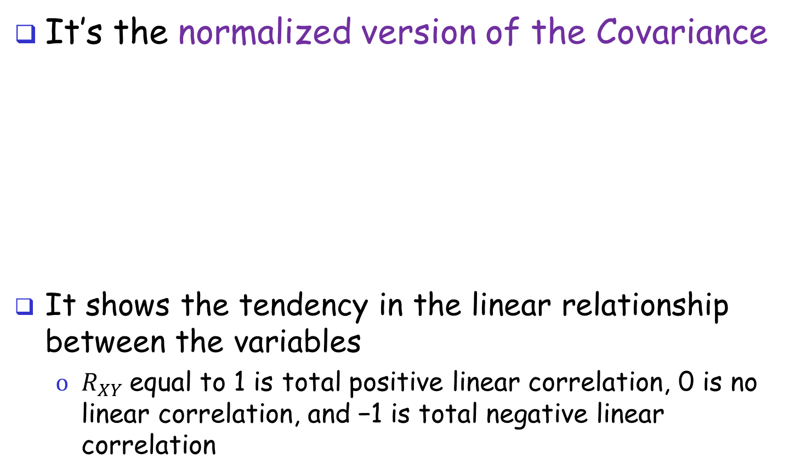
Correlation Coefficient
It’s the normalized version of the Covariance
It shows the tendency in the linear relationship between the variables
$R_{XY}$equal to 1 is total positive linear correlation, 0 is no linear correlation, and −1 is total negative linear correlation
Notes:
Why inverse correlation?

Slide 41
Examples of r_{XY} in 2-d
Notes:
A and C have positive slop, while B and D have negative slop

Slide 42
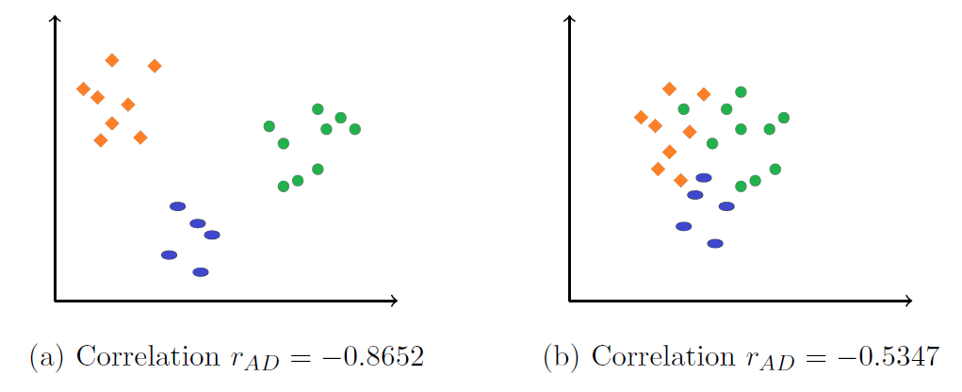
Examples of r_{XY} in 2-d
Farer from 0, the better!
Notes:
A and C have positive slop, while B and D have negative slop

Slide 43
Similarity Matrix
Form “similarity matrix”
Could be based on just about anything
For example, distance matrix D = {d_{ij}}, where d_{ij} = d(x_{i},x_{j})
Group rows and columns by cluster
Make a heat map of resulting matrix
Provides visual representation of similarity within clusters (so look at it…)

Slide 44
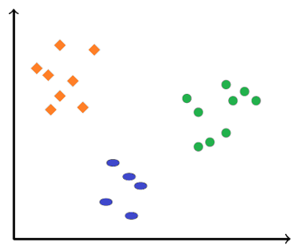
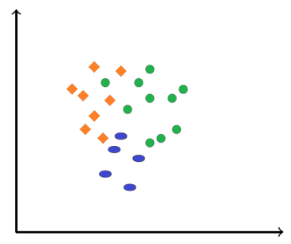
Heat Maps

Slide 45
Other techniques
Residual sum of squares (RSS)
Cohesion and Separation
Silhouette Coefficient
Basically Cohesion and Separation in a single value
External Validation
Several techniques that measure quality based on data in clusters, not relying on cluster topology (“shape”)

Slide 46
EM Clustering
Samples might be from different probability distributions
Euclidean distance might be poor measure
Maybe better to cluster by distribution
Cluster using probability distributions?
Good idea, but distributions are unknown…
Expectation maximization (EM)
Can determine unknown parameters of probability distributions
Notes:
Expectation maximization (EM) is a general concept. For example, with HMMs, when we find the “best” hidden state sequence, we maximize the expectation.

Slide 47
EM for Clustering
How is EM relevant to clustering?
Can use EM to obtain parameters of K “hidden” distributions
That is, means and variances, μ_{i} and σ_{i}²
Then, use μ_{i} as centers of clusters
And σ_{i} (standard deviations) as “radii”
Often use Gaussian (normal) distributions
Is this better than K-means?

Slide 48
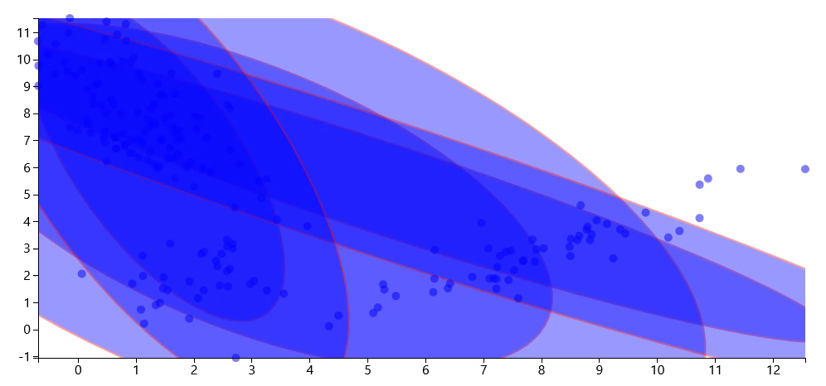
Notes:
http://en.wikipedia.org/wiki/Expectation–maximization_algorithm
https://www.bayesserver.com/Visualizations/Clustering.aspx

Slide 49
EM vs K-Means
Whether it is better or not, EM is obviously different than K-means…
…or is it?
K-means is like a special case of EM
Using “distance” instead of “probabilities”
In K-means, we re-assign points to centroids
Like “E” in EM, which “re-shapes” clusters
In K-means, we recompute centroids
Like “M” of EM, where we recompute parameters
Notes:
One difference between K-means and EM is that the former makes “hard” assignments to clusters, whereas the latter can be viewed as making “soft” assignments. That is, in the first step of the 2-step K-means process, we assign each point to a cluster. In contrast, in the “E” step of the EM, we only make probabilistic assignments to clusters. For K-means, we could use the distance from the centroid as a way to “weight” points so that they are partly in multiple clusters, but this is maybe not so obvious as with EM clustering.

Slide 50
Conclusion
Clustering is fun, entertaining, and useful
Can explore mysterious data, and more…
And K-means is really, really simple
EM is powerful and not much more difficult
Different distributions yield different “shapes”
Measuring clustering success is not so easy
“Good” clusters? Useful results? Or noise?
Anything can be clustered!
Clustering is often just a starting point
Can helps us decide if any “there” is there

Slide 51
Clustering Application

Slide 52
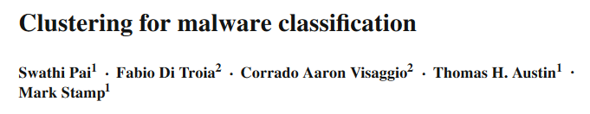
We analyze just part of this research work

Slide 53
Quest for the Holy Grail
Holy Grail of malware research is to detect previously unseen malware
So-called “zero day” malware
If you solve this problem, you’ll be rich
We don’t consider this problem here
But we do consider something similar
Problem here… classify “new” malware
New in a sense…

Slide 54
Training HMMs
Train HMM for each of the following…
Four compilers
GCC, MinGW, TurboC, Clang
Hand-written assembly code
We refer to this model as TASM
Two metamorphic families
NGVCK and MWOR

Slide 55
Scoring
For each malware sample under consideration…
Score sample with each of 7 models
GCC, Clang, TurboC, MinGW, TASM, NGVCK, MWOR
Each score is normalized (LLPO)
For each malware sample, obtain a vector of 7 (normalized) HMM scores

Slide 56
Clustering Details
Suppose we have N malware samples,
m₁,m₂,…,m_{N}
Suppose score vector for m_{i} is
(a_{i}, b_{i}, c_{i}, d_{i}, e_{i}, f_{i}, g_{i})
Let a_{min} = min{a_{i}} and a_{max} = max{a_{i}}
Given K, the number of cluster
Let a = (a_{max} – a_{min}) / (K+1)
Define b, c, d, e, f, g similarly

Slide 57
Initial Centroids
For j = 1,2,…,K define initial centroids
C_{j} = (a_{min} + j a, b_{min} + j b, …, g_{min} + j g)
Note that we have divided each range into equal-sized segments
Uniformly spaced initial centroids
Once initial centroids are computed, samples clustered to nearest centroid

Slide 58
Update Centroids
Suppose cluster j has n malware samples
Denote these samples as m₁,m₂,…,m_{n}
Then the scores are given by

Slide 59
Update Centroids
Let a_{mean} = (a₁ + a₂ + … + a_{n}) / n
And similarly for b_{mean}, c_{mean}, …, g_{mean}
Then the new centroid is
C_{j} = (a_{mean}, b_{mean}, c_{mean}, …, g_{mean} )
And thus the name, K-means

Slide 60
Update Clusters
After all K centroids computed…
Regroup malware samples, based on nearest centroid
Recompute centroids (as on previous slide) and regroup…
Continue until no significant change occurs when regrouping
Definition of K-means clustering!!!

Slide 61
Experiments
Performed clustering, K = 2 to K = 15
Results on next slides…
Using all 7 scores
Uniform initial centroids
And N = 2 hidden states in all HMMs
Also experimented with
Combinations of 7 (or less) scores, uniform vs random initial centroid, N in HMMs, …

Slide 62
Measuring Success
Can we quantify the quality of results?
Ideally, each cluster should include only one family (i.e., one color)
Here, we focus on 3 dominant families
Winwebsec, Zbot, Zeroaccess
How to measure this?

Slide 63
Measuring Success
Let C₁,C₂,…,C_{k} be final the clusters
Let
x_{i} = number of Winwebsec in C_{i}
y_{i} = number of Zbot in C_{i}
z_{i} = number of Zeroaccess in C_{i}
M_{i} = max{x_{i},y_{i},z_{i}}
Then define score = (M₁ + M₂ + … + M_{k}) / T
Where T is total of Winwebsec, Zbot, and Zeroaccess files
Notes:
Note that this score tells us what percentage of the 3 dominant families are a majority in their respective clusters.

Slide 64
Measuring Success
Recall, score = (M₁ + M₂ + … + M_{k}) / T
Note that 0 < score ≤ 1
And, score = 1 implies all clusters are uniform (wrt 3 major families)
Suppose we classify simply based on dominant family in a cluster
Then score = 1 is a perfect result
Wrt the three major families

Slide 65
Clusters for Classification
Our “score” is accuracy if we classify based on dominant type in cluster
That is, score samples of unknown type by clustering to nearest centroid
And classify by dominant type in cluster
Previous slide says we can get more than 0.82 correct in this manner
Good? Bad? Compared to what?

Slide 66
Clusters for Classification
From previous table
4361 Winwebsec
2136 Zbot
1306 Zeroaccess
Total of these three is 7803
Suppose we expect to see only these 3 families, and at these rates
Can use expected number to “classify”

Slide 67
Classification
Classifying based on expected number
Probability of success is about 0.415
Why?
So, classifying at 0.82 is not too bad
Is this good enough to be of any use?
Much better than “random”
But how might we actually use it?

Slide 68
Discussion
Here HMMs not specific to families
Results show we get decent results
Can expect to “classify” previously unseen malware at about these rates
How could this be useful?
Malware may be similar to that in cluster
So, possibly faster analysis/response
Also relevant to classification/naming

Slide 69
Conclusion
HMM scoring scheme able to classify unrelated malware with good accuracy
Malware is unrelated to scores used
Not accurate enough for detection
Only 82% accuracy in this work
But, other potential uses
As an aid in analysis of new malware
As a tool for classification/naming

